Slide 1

Oracle 11g: SQL
Chapter 8
Restricting Rows and Sorting Data

Slide 2
Objectives
Use a WHERE clause to restrict the rows returned by a query
Create a search condition using mathematical comparison operators
Use the BETWEEN…AND comparison operator to identify records within a range of values
Specify a list of values for a search condition using the IN comparison operator
Oracle 11g: SQL

Slide 3
Objectives (continued)
Search for pattern matches using the LIKE comparison operator
Identify the purpose of the % and _ wildcard characters in patterns
Join multiple search conditions using the appropriate logical operator
Perform searches for NULL values
Specify the order for the presentation of query results using an ORDER BY clause
Oracle 11g: SQL

Slide 4
WHERE Clause Syntax
A WHERE clause is used to retrieve rows based on a stated condition
Requires:
  Column name
  Comparison operator
  Value or column for comparison
Non-numeric values must be in single quotes
String values are case sensitive
Oracle 11g: SQL

Slide 5
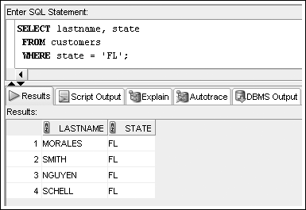
WHERE Clause Example
List WHERE clause after FROM clause
Oracle 11g: SQL

Slide 6
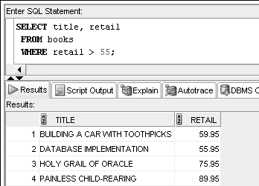
Comparison Operators
Indicate how the data should relate to the given search value
Oracle 11g: SQL

Slide 7
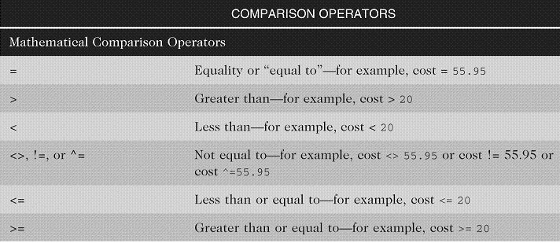
Arithmetic Comparison Operators
Oracle 11g: SQL

Slide 8
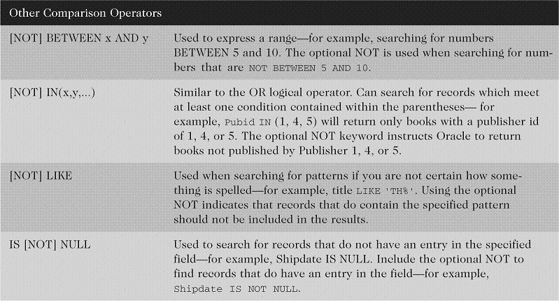
Other Comparison Operators
Oracle 11g: SQL

Slide 9
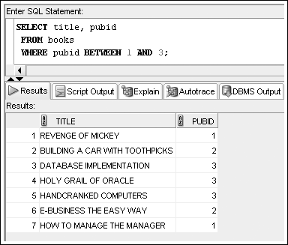
BETWEEN…AND Operator
Finds values in a specified range (inclusive)

Slide 10
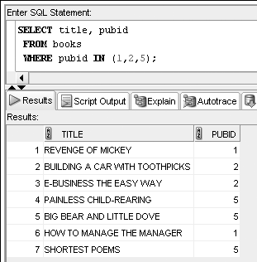
IN Operator
Returns records that match a value in a list
List values in parentheses, separated by commas
Oracle 11g: SQL

Slide 11
LIKE Operator
Performs pattern searches
Used with wildcard characters
  Underscore (_) for exactly one character in the indicated position
  Percent sign (%) represents any number of characters
Oracle 11g: SQL

Slide 12
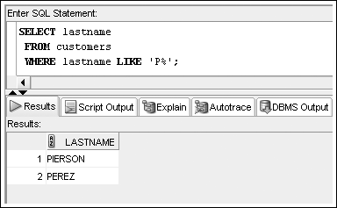
LIKE Operator Example
Oracle 11g: SQL

Slide 13
Resolving Multiple Types of Operators
Arithmetic operators
Comparison operators
Logical operators
  Evaluated in order of NOT, AND, OR
    NOT – reverses meaning
    AND – both conditions must be TRUE
    OR – at least one condition must be TRUE
Oracle 11g: SQL

Slide 14
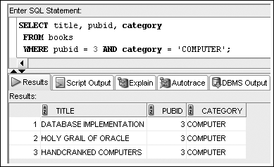
AND Logical Operator Example
Oracle 11g: SQL

Slide 15
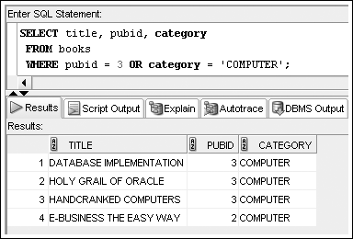
OR Logical Operator Example
Oracle 11g: SQL

Slide 16
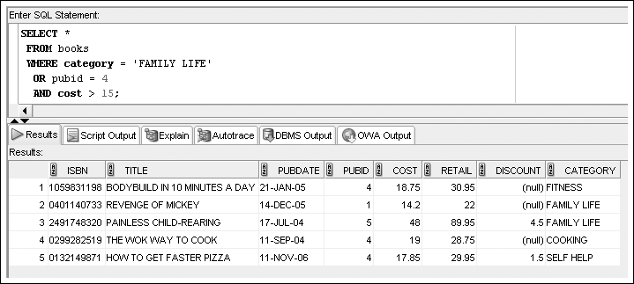
Multiple Logical Operators
Resolved in order of NOT, AND, OR
Oracle 11g: SQL

Slide 17
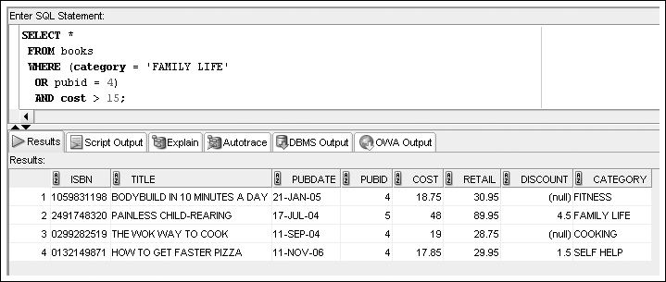
Multiple Logical Operators
Use parentheses to override the order of evaluation
Oracle 11g: SQL

Slide 18
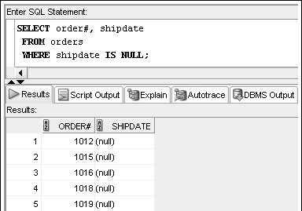
Treatment of NULL Values
Absence of data
Requires use of IS [NOT] NULL operator
Oracle 11g: SQL

Slide 19
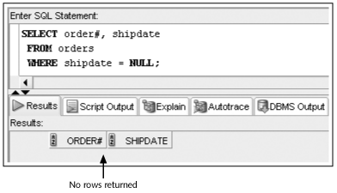
Treatment of NULL Values (continued)
A common mistake is using = NULL, which does not raise an error but also does not return any rows
Oracle 11g: SQL

Slide 20
ORDER BY Clause Syntax
The ORDER BY clause presents data in sorted order
Ascending order is default
Use DESC keyword to reverse order
255 columns maximum
Oracle 11g: SQL

Slide 21
ORDER BY Clause Syntax
Sort Sequence
In ascending order, values will be listed in the following sequence:
  Numeric values
  Character values
  NULL values
In descending order, sequence is reversed
Oracle 11g: SQL

Slide 22
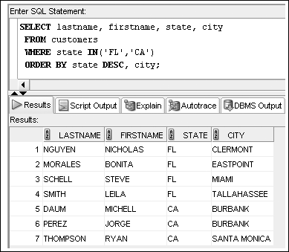
ORDER BY Example

Slide 23
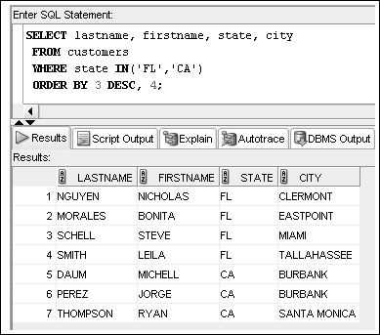
ORDER BY Can Reference
Column Position

